Slide 1
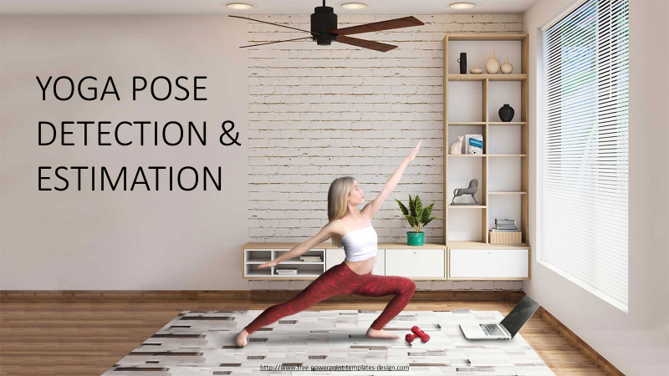
Here is where your presentation begins

Slide 2
PROCEDURE
Pose Detection and Classification Module:
Utilizes the MediaPipe library for pose detection.
Defines functions to detect pose landmarks, calculate angles between landmarks, and classify yoga poses.
Import Necessary Library
Webcam Integration:
Opens a connection to the webcam using OpenCV (cv2).
Checks if the webcam is opened successfully.
Django Integration:
Includes Django components in the code, such as rendering HTML templates, creating views, and handling redirects.
Function in detect and recognition pose in keypoint using Mediapipe.

Slide 3
Web Interface: Defines an HTML template (upload_webcam.html) for a simple web interface. Provides a button to trigger pose detection using the webcam. Offers a button to stop the webcam and redirect to the upload page Pose Detection Loop: Continuously captures frames from the webcam. Performs pose detection and classification on each frame. Displays the processed frame with pose landmarks and label in real-time. Pose Classification: Defines specific criteria for classifying yoga poses based on angles between joints. Uses predefined pose ranges for various yoga poses. Determines the nearest pose and calculates differences from the nearest pose. Display and Redirect: Displays the output frame with pose landmarks and labels in a separate window.

Slide 4
Django Server Handling: Manages Django server functionality. Uses Django's redirect function to navigate to different pages User Interaction: Users can interact with the web interface to initiate and stop pose detection. Project Termination: Properly releases the webcam and closes OpenCV windows when the pose detection loop is terminated

Slide 5
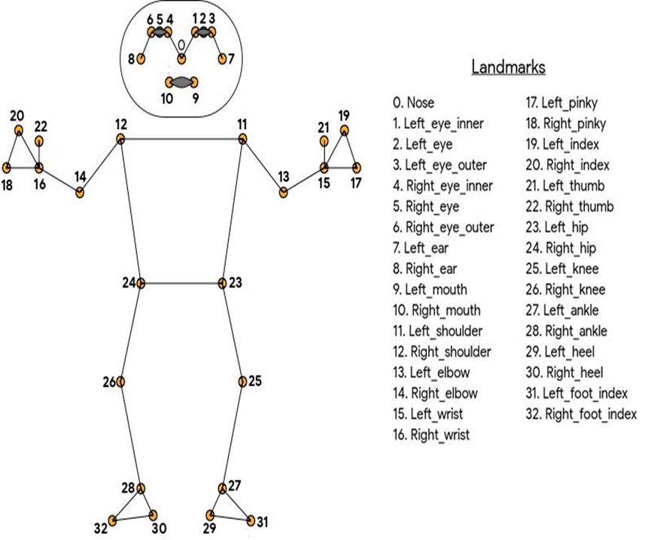
MEDIAPIPE & LANDMARKS
MediaPipe:
an open-source framework developed by Google that provides ready-to-use, cross-platform solutions for various perceptual tasks, including pose estimation, hand tracking, object detection, and more, using machine learning and computer vision techniques.
Landmarks:
MediaPipe's pose estimation model identifies specific points or landmarks on the human body, typically around 33 landmarks. These landmarks represent key joints and parts of the body, such as shoulders, elbows, wrists, hips, knees, and ankles. For yoga pose estimation, these landmarks serve as crucial reference points to analyze and identify the posture of the body.

Slide 6
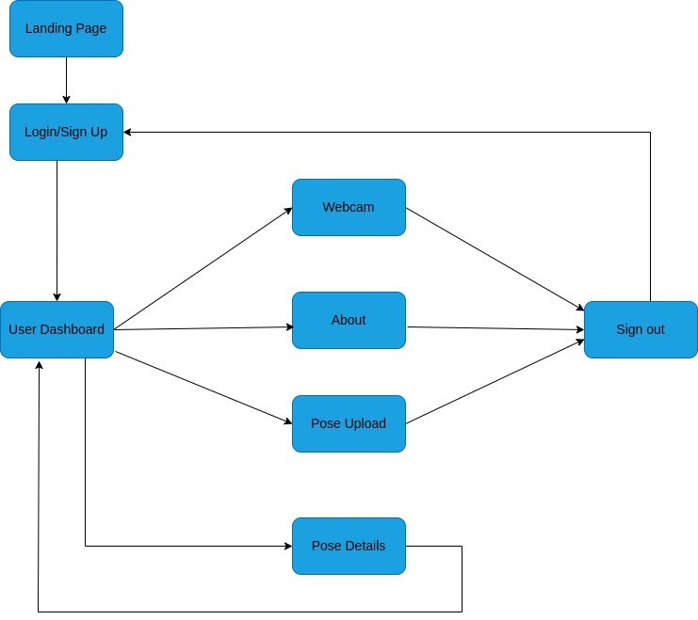
FLOW CHART

Slide 7
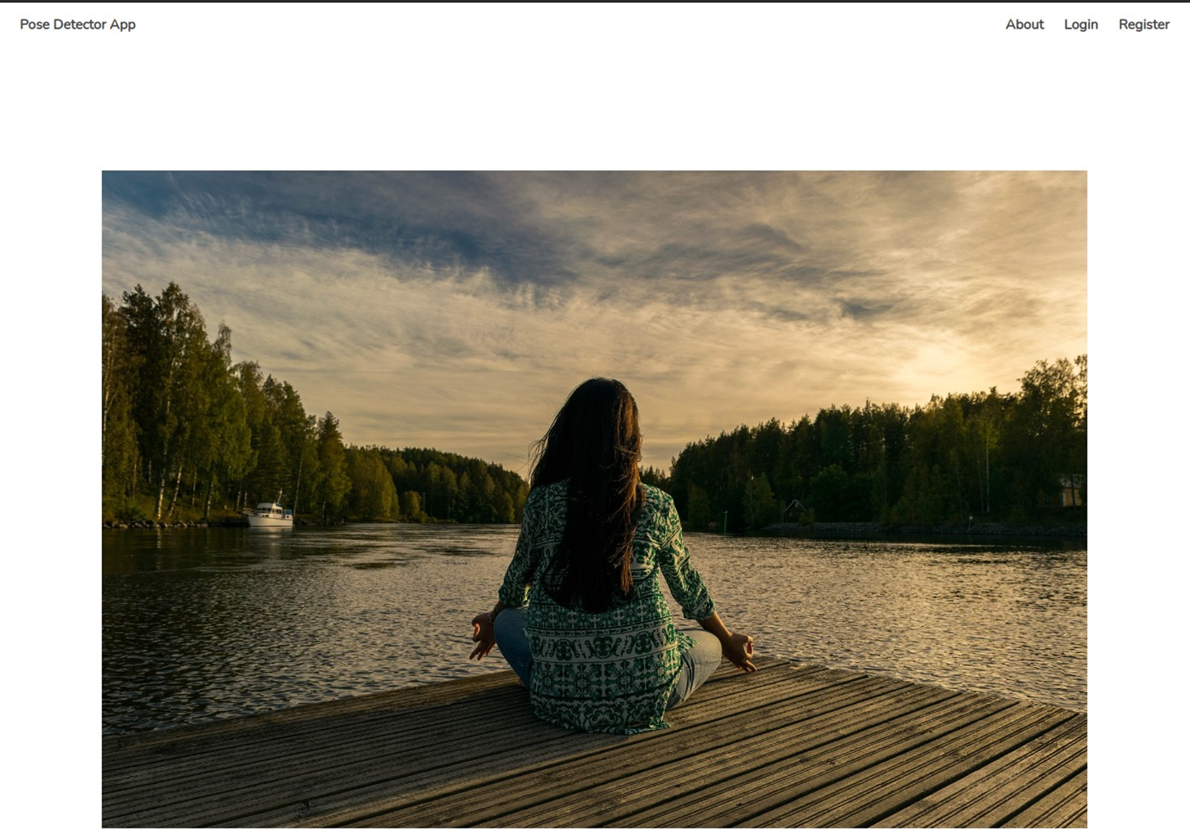
HOME PAGE
YOGA POSE ESTIMATION

Slide 8
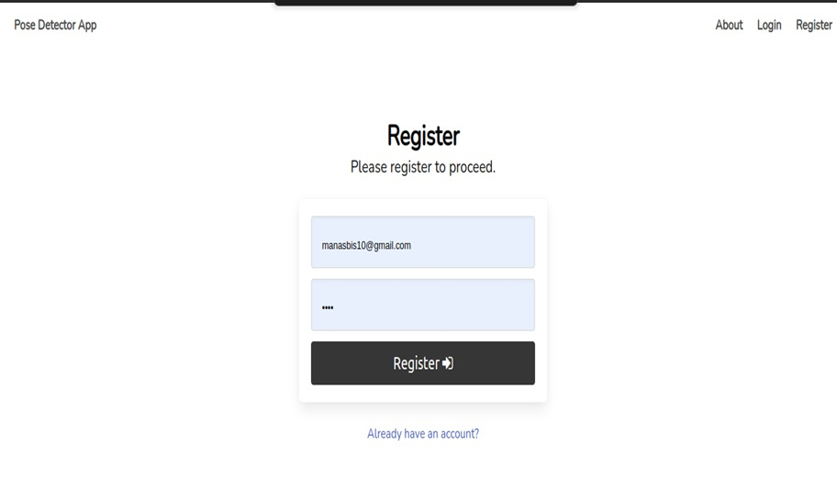
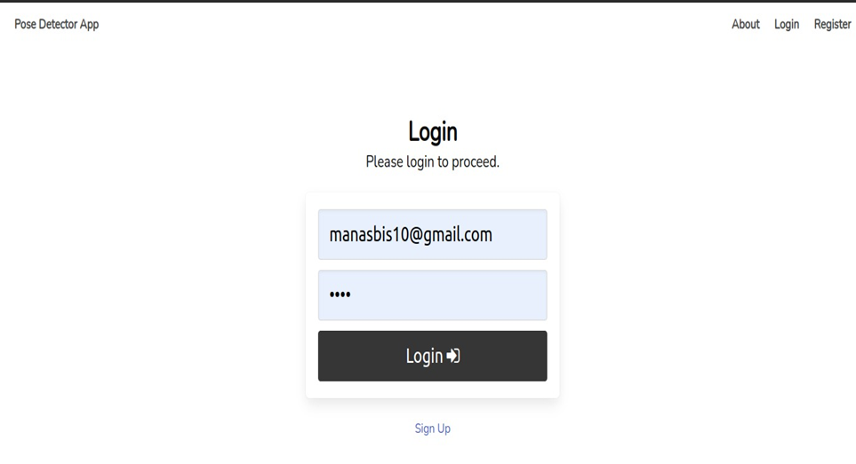
REGISTER & LOGIN PAGE
Register Page:
Allow users to create accounts by inputting details like username, email, and password securely.
Implement validation checks for unique usernames and proper email formats to ensure data integrity.
Login Page:
Provide a secure login interface where users can input their registered credentials (username/email and password).
Validate user inputs and authenticate against stored credentials to grant access to the yoga pose features.

Slide 9
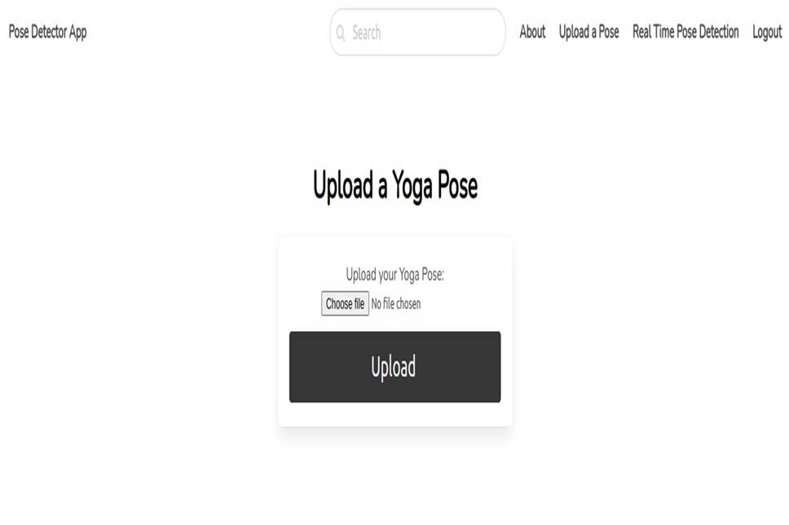
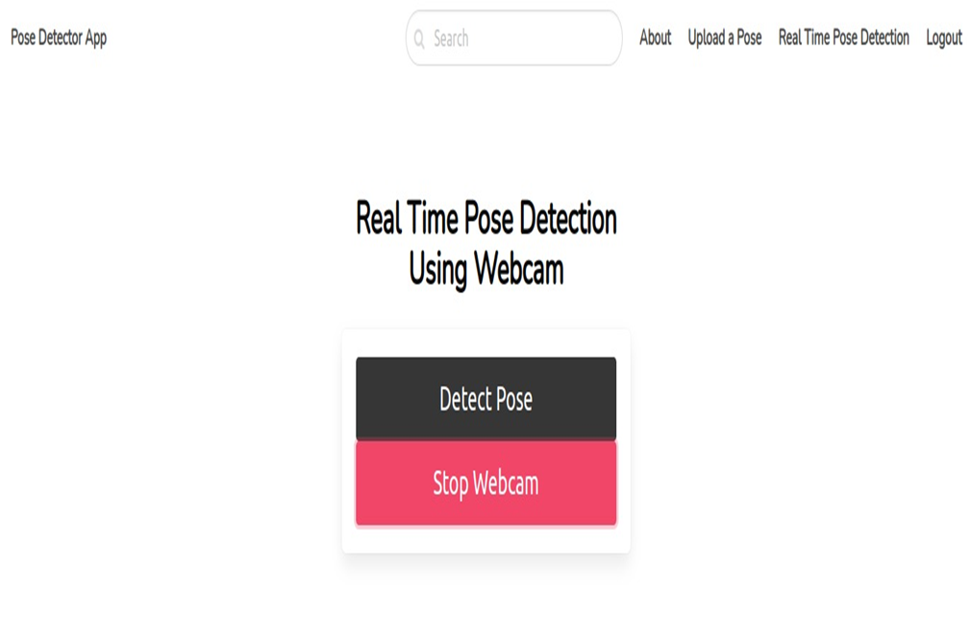
UPLOAD IMAGE & USE WEBCAM

Slide 10
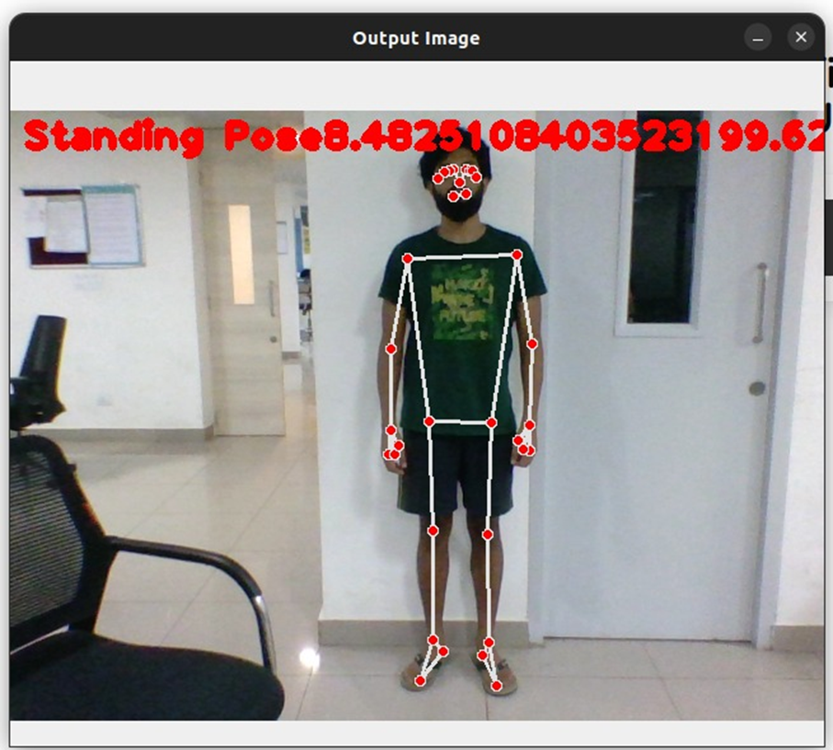
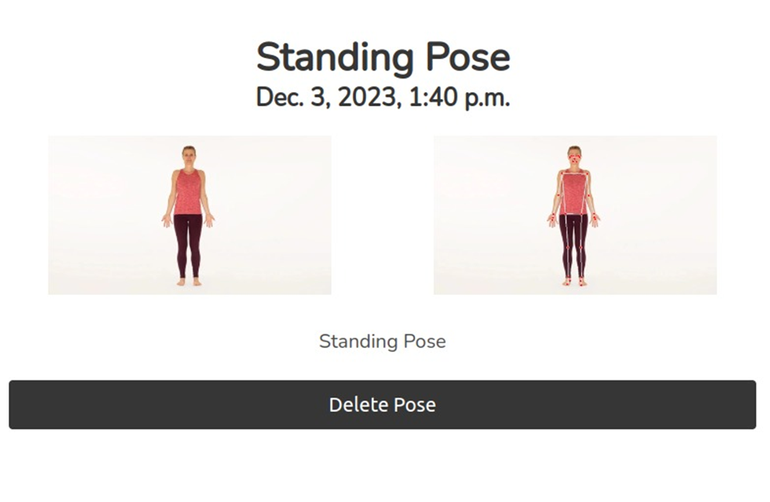
STANDING POSE

Slide 11
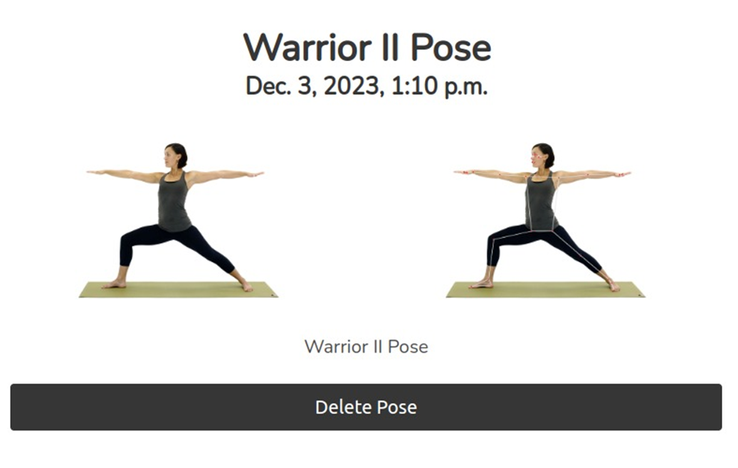
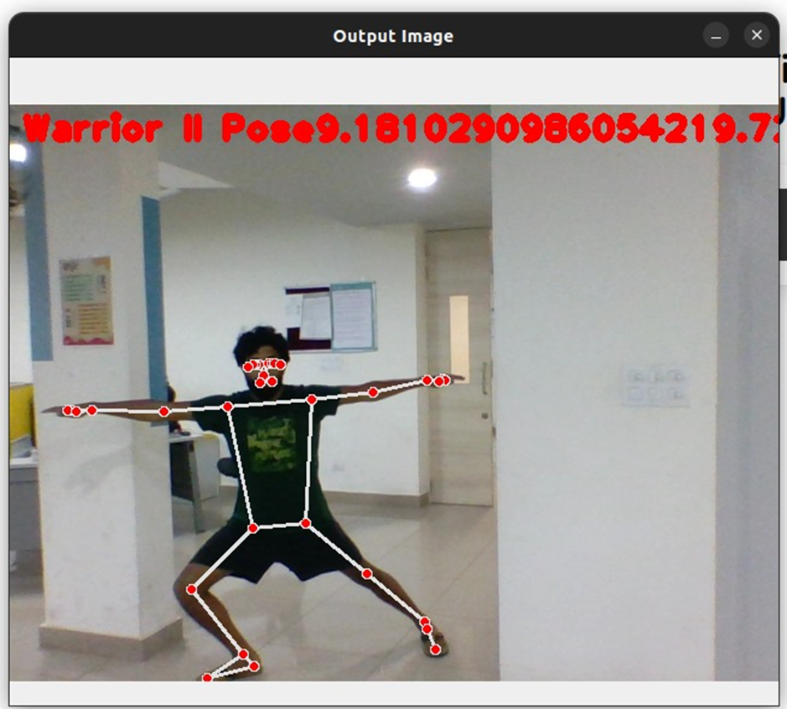
WARRIOR II POSE

Slide 12
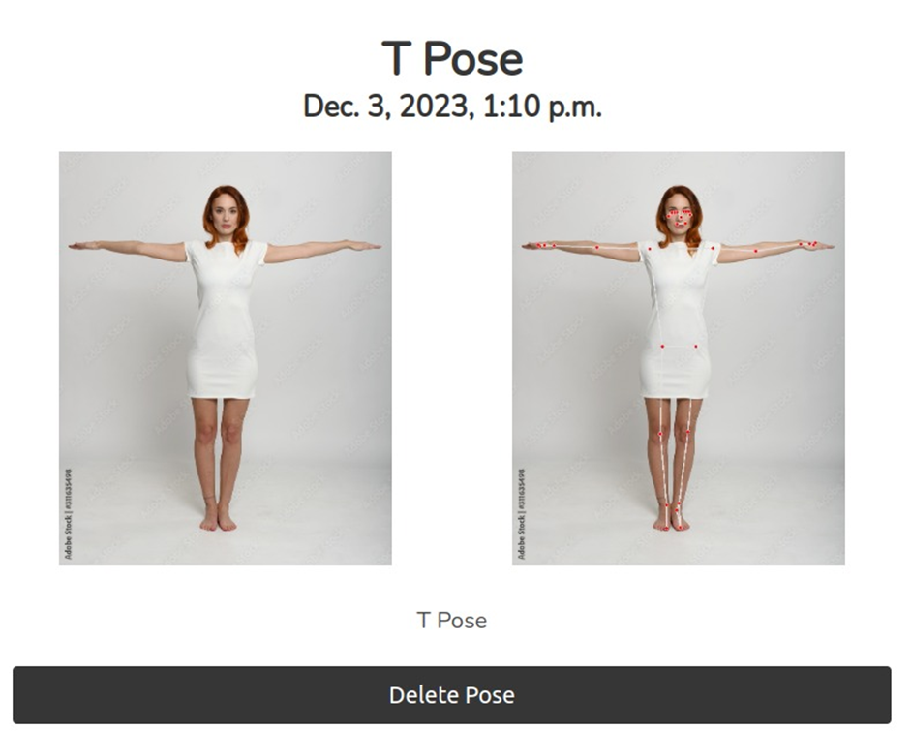
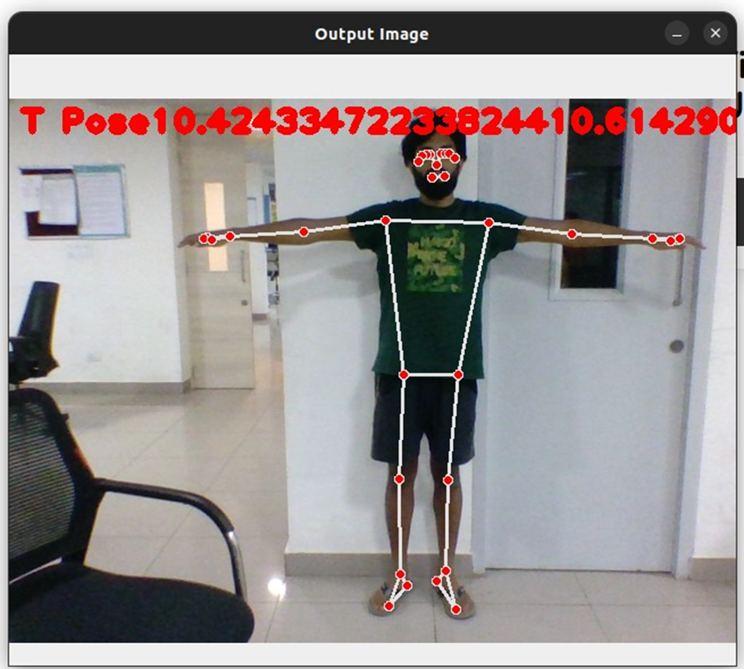
T POSE

Slide 13
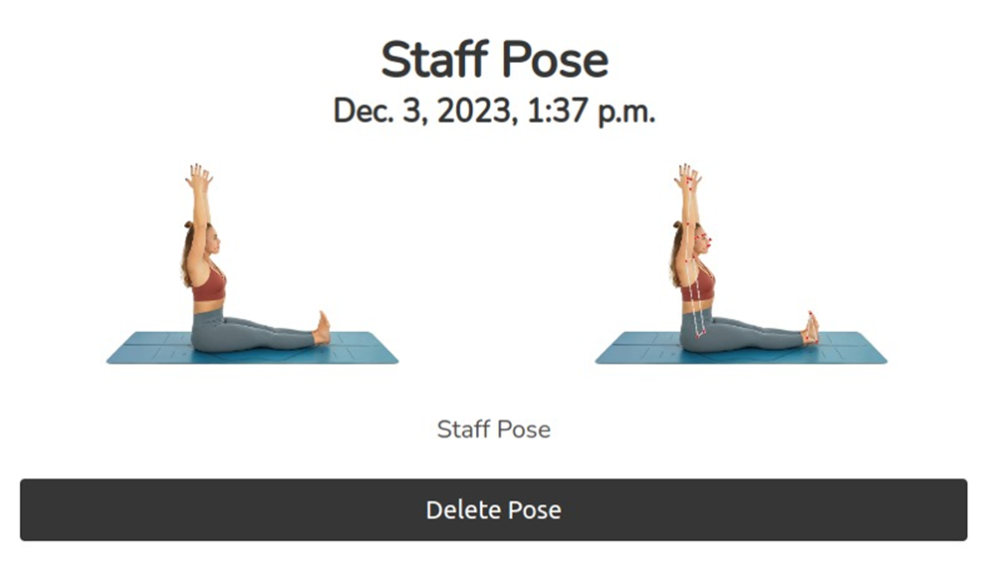
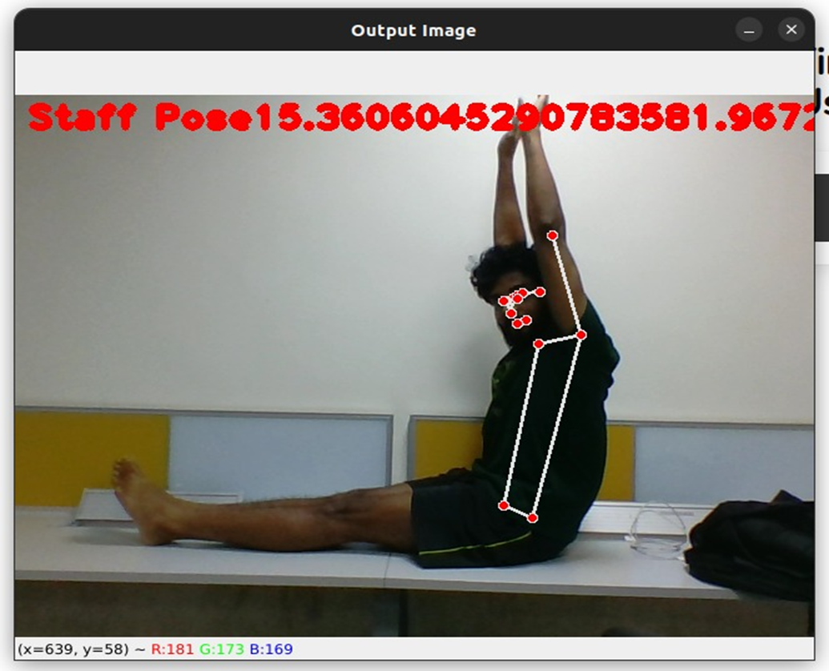
STAFF POSE

Slide 14
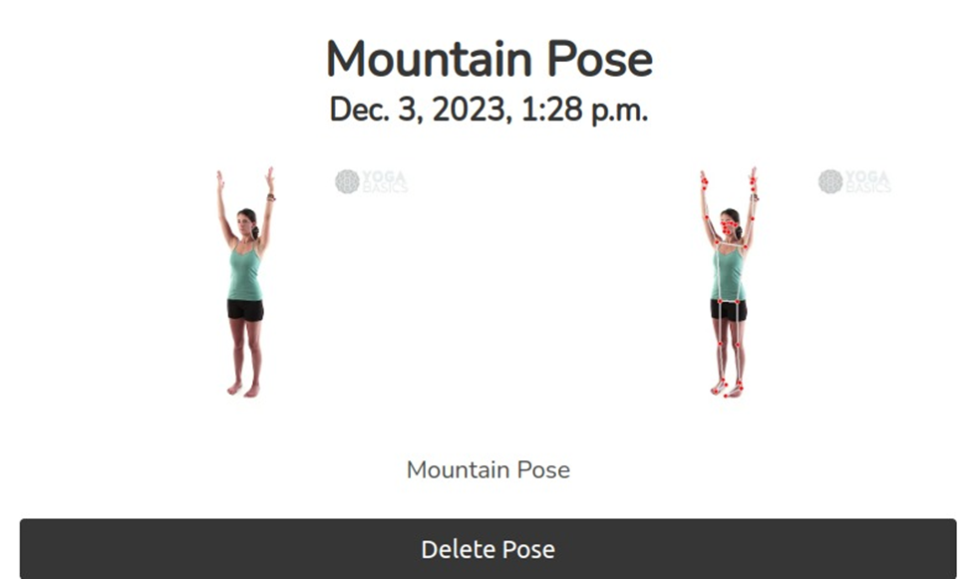
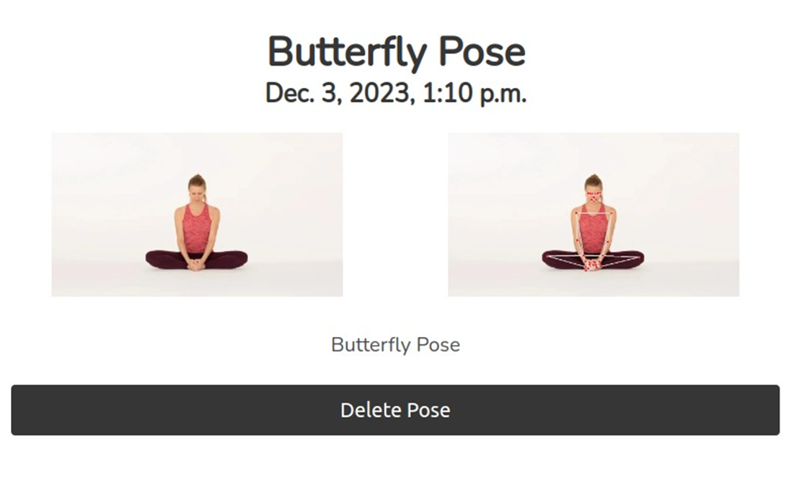
MOUNTAIN & BUTTERFLY POSE

Slide 15
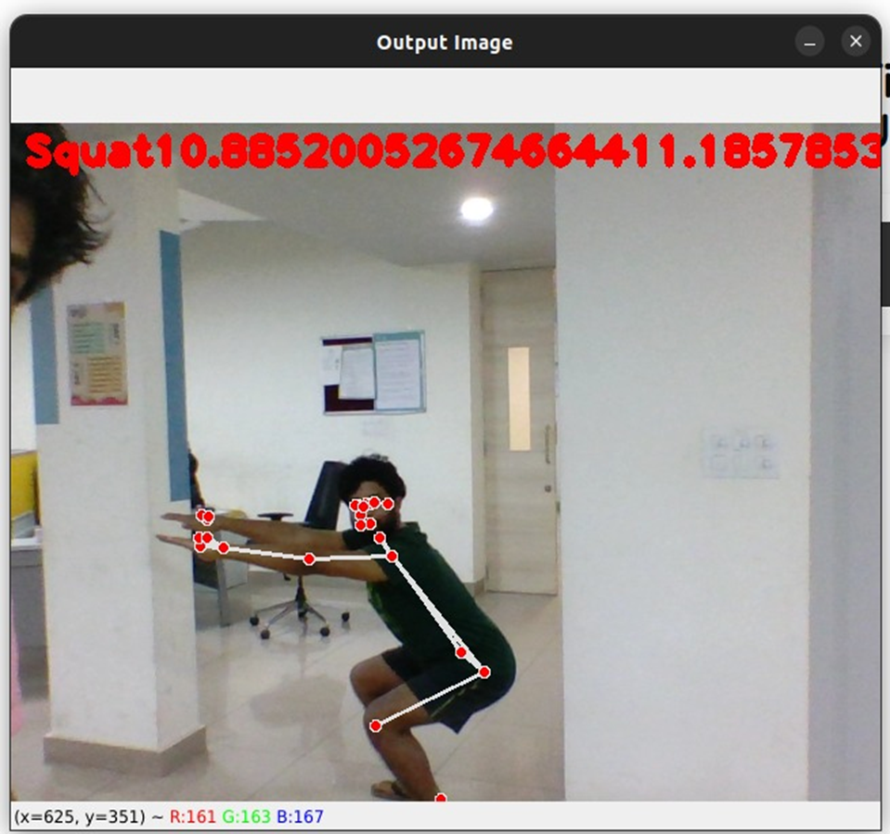
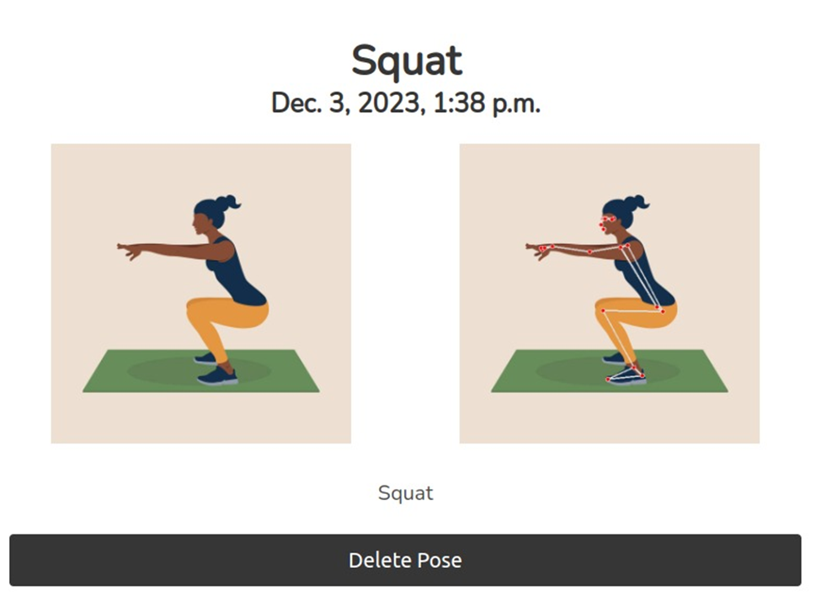
SQUAT POSE

Slide 16
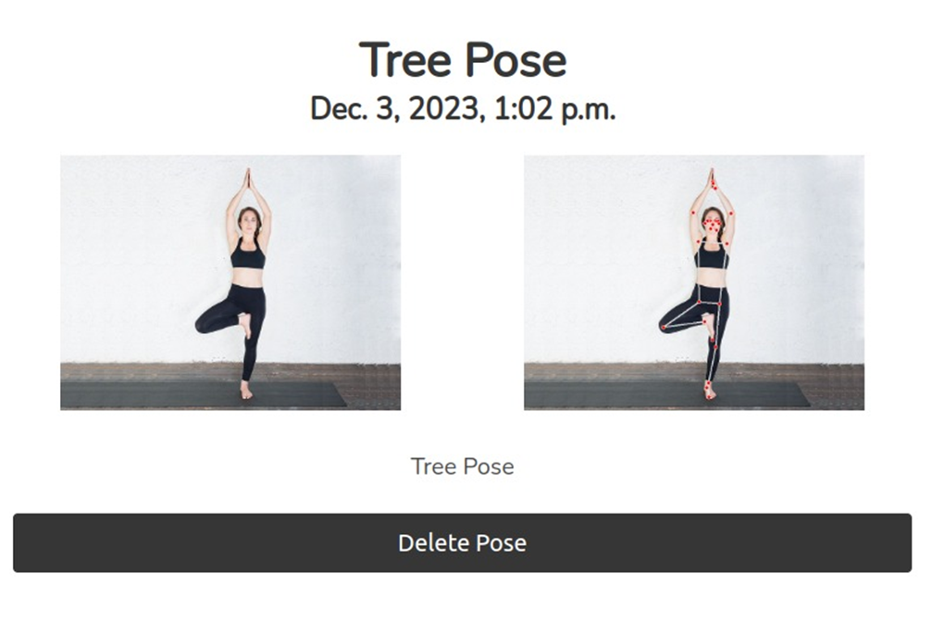
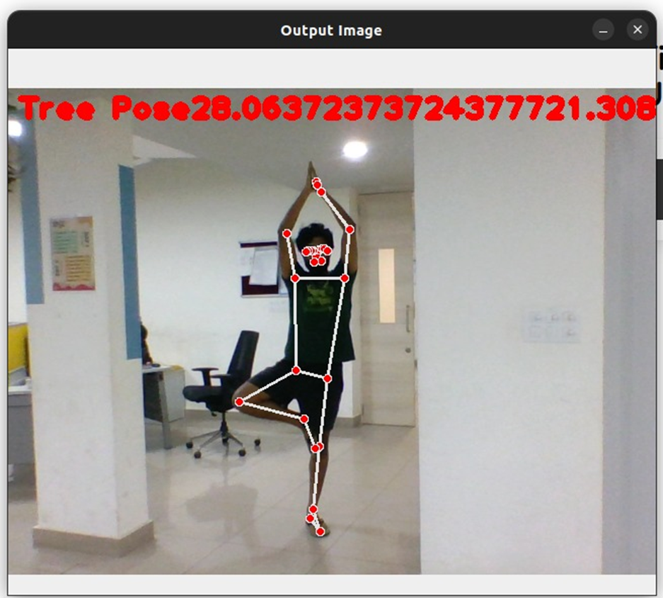
TREE POSE

Slide 17
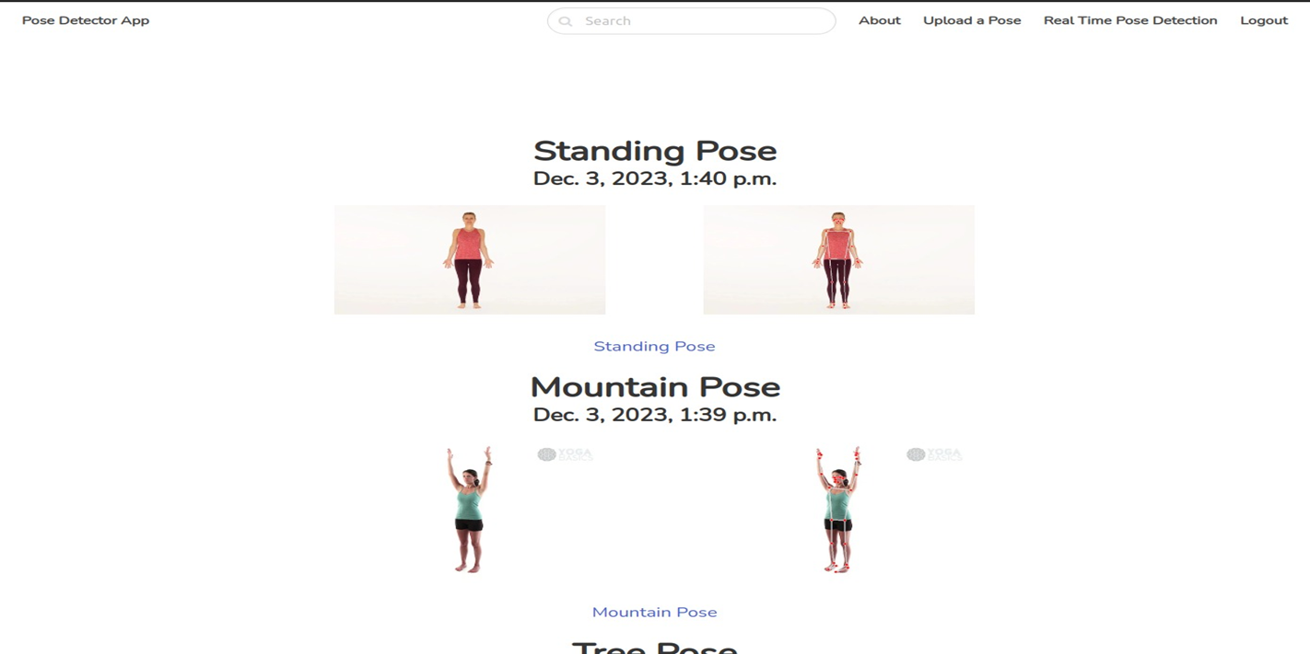
HISTORY
Each User have history.

Slide 18
TECHNOLOGY USED
PYTHON: Used as primary language to code
CV: library for computer vision ,open source
DJANGO: Backend with Python
MEDIAPIPE: All mediapipe library
BULMA: Style Framework HTML: Basic Structure of Page
CSS: Styling the web Page.
SQLlite: DataBase to store Data.

Slide 19
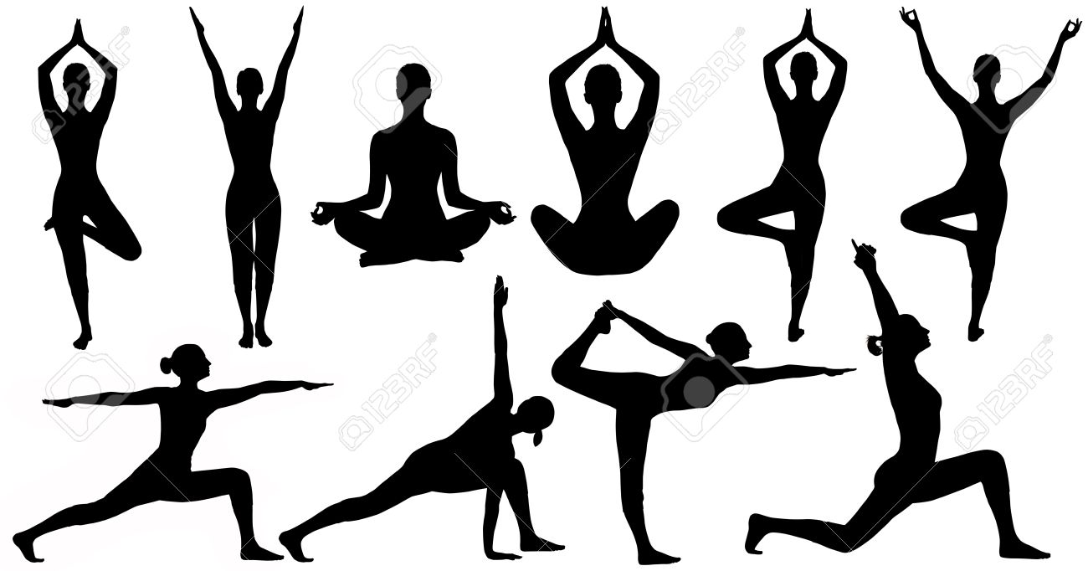
THANK YOU
MADE BY:
MEDHA MADHUSUDAN 2023202001
MANGLESH PATIDAR 2023201059
MANAS KUMAR BISWAS 2023201016
JAWED EQUBAL 2023201051

